Slide 1


RichardsonFunds.AI
Notes:
Warren Buffet has a photographic memory. Buffett follows "literally every publicly traded company.“ At Hathaway, Warren Buffett has increased its book value per share from $19.46 to $144,565 as of September 30, 2014. This is an absolutely staggering gain of 742,783%.
Everytime there is a new technology on the horizon, it changes the . Creates new opportunities for certain industries and new threats for some others. We are going to see how the advent of AI is going to change the financial stock prediction

Slide 2
Agenda
Problem Statement
Why now?
How?
Results
Summary
1
2
3
4
5

Slide 3
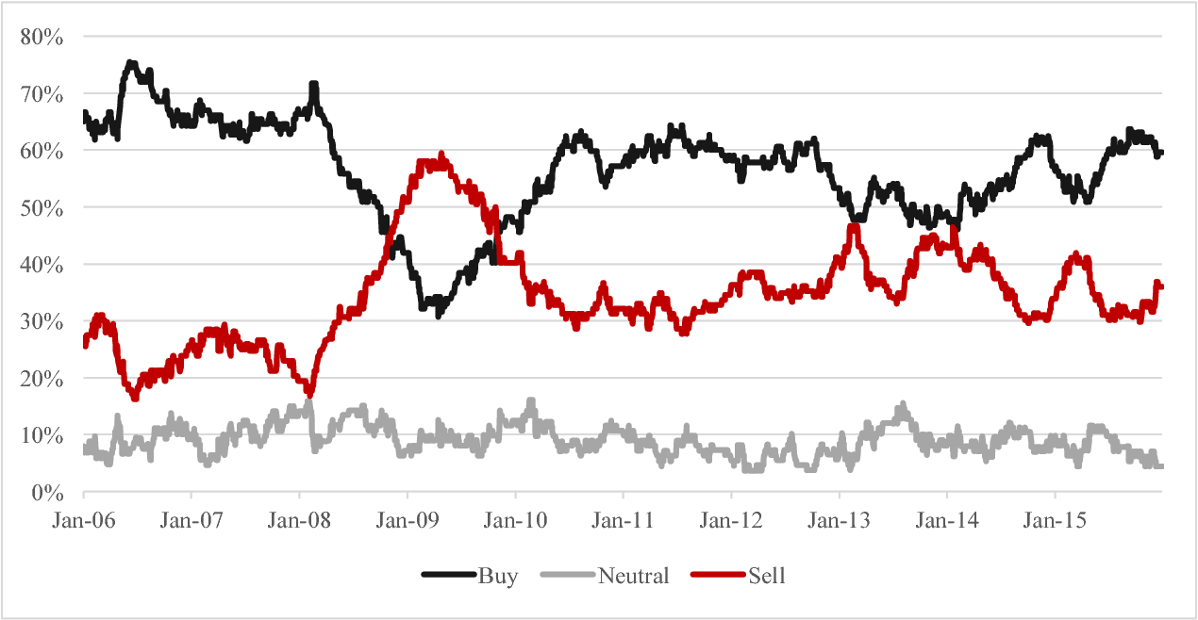
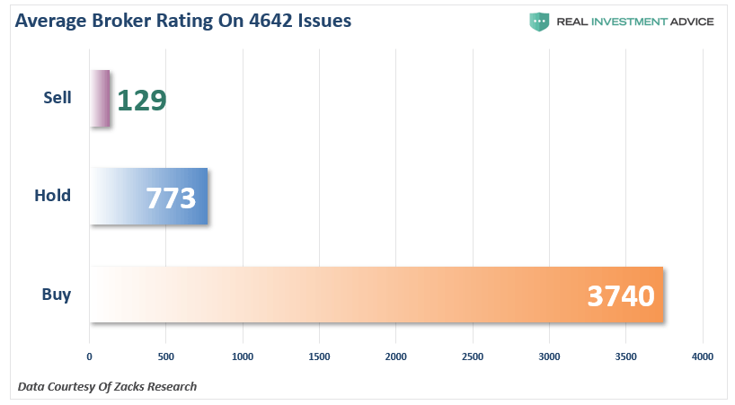
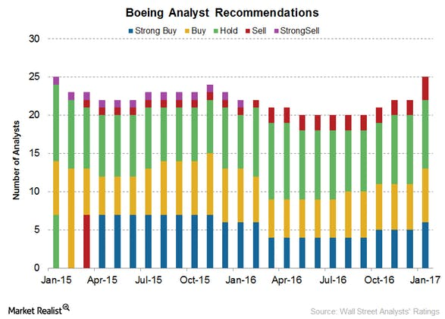
Stock Prediction
What to Buy?
What to hold?
What to Sell?

Slide 4

… leads to 70% of the actively managed funds lagging Index
Lots of unknowns in stock prediction
Product
Market
PESTLE Environment
Competition
Future Products
Employees
Cost Structure
Suppliers

Slide 5
Roadmap

Slide 6
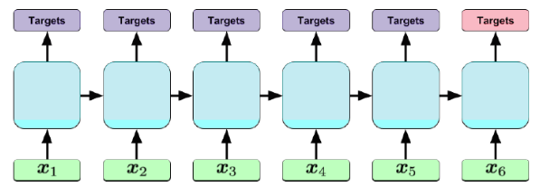
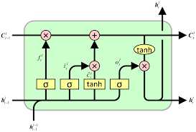
Time Series AI/ ML Models to the rescue - LSTM

Slide 7
Details

Slide 8
Hit Ratio

Slide 9











Selected a very well diversified group of stocks – Top 50 Stocks on S&P for modeling and comparison

Slide 10
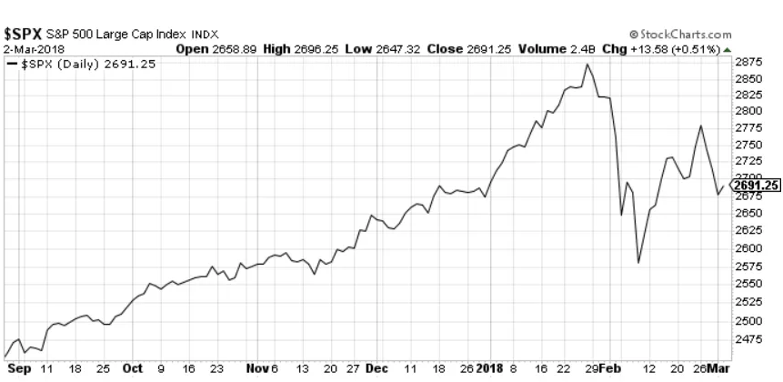
Benchmark to beat is buy and hold

Slide 11
Results
LSTM vs. SVM. Vs. Buy and Hold

Slide 12
Asset/ Stock Decision Tree

Slide 13
Portfolio Results

Slide 14
Next Steps
More input – Sentiment analysis
GRU ( faster)
Expand stocks (analysis)

Slide 15
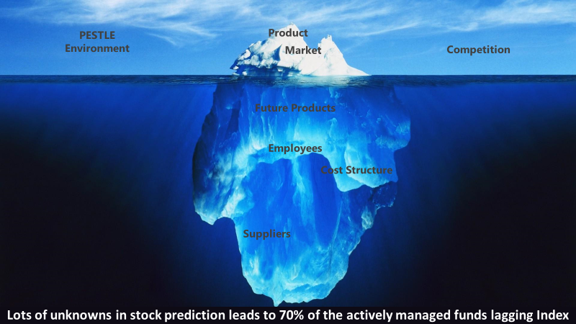
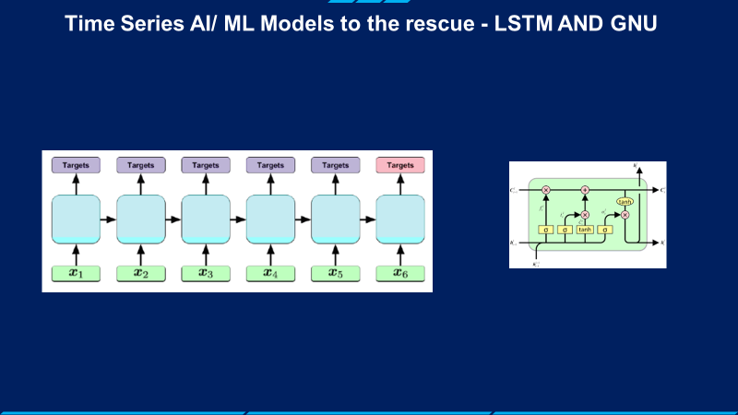
Summary

Slide 16
Things that didn’t work
Price Prediction didn’t work

Slide 17

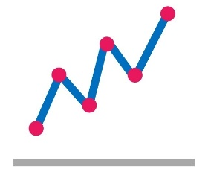




The Analytics Process: CRISP-DM
Business Understanding
Understand the business operations and customer experience
Data Exploration
Understand the data available and how it is related
Data Preparation
Organize and clean the data
Analysis / Modeling
Conduct the analysis using the appropriate techniques
Evaluation
Interpret the results within the business context
Deployment
Integrate the findings/model into the business decisions or processes
Notes:
CRISP-DM: Cross Industry Standard Process for Data Mining
Business Understanding
This initial phase focuses on understanding the project objectives and requirements from a business perspective, and then converting this knowledge into a data mining problem definition, and a preliminary plan designed to achieve the objectives. A decision model, especially one built using the Decision Model and Notation standard can be used.
Data Preparation
The data preparation phase covers all activities to construct the final dataset (data that will be fed into the modeling tool(s)) from the initial raw data. Data preparation tasks are likely to be performed multiple times, and not in any prescribed order. Tasks include table, record, and attribute selection as well as transformation and cleaning of data for modeling tools.
Modeling
In this phase, various modeling techniques are selected and applied, and their parameters are calibrated to optimal values. Typically, there are several techniques for the same data mining problem type. Some techniques have specific requirements on the form of data. Therefore, stepping back to the data preparation phase is often needed.
Evaluation
At this stage in the project you have built a model (or models) that appears to have high quality, from a data analysis perspective. Before proceeding to final deployment of the model, it is important to more thoroughly evaluate the model, and review the steps executed to construct the model, to be certain it properly achieves the business objectives. A key objective is to determine if there is some important business issue that has not been sufficiently considered. At the end of this phase, a decision on the use of the data mining results should be reached.
Deployment
Creation of the model is generally not the end of the project. Even if the purpose of the model is to increase knowledge of the data, the knowledge gained will need to be organized and presented in a way that is useful to the customer. Depending on the requirements, the deployment phase can be as simple as generating a report or as complex as implementing a repeatable data scoring (e.g. segment allocation) or data mining process. In many cases it will be the customer, not the data analyst, who will carry out the deployment steps. Even if the analyst deploys the model it is important for the customer to understand up front the actions which will need to be carried out in order to actually make use of the created models.

